Slide 1
IE2042 – Database Management Systems for Security
Module Introduction
Dr. Harinda Fernando

Slide 2
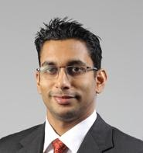
Meet the Lecturer
Dr. Harinda Fernando
PhD, BBIT (Hons) – Deakin
FHEA, MIEEE
Main Teaching Areas
Networking and Network Security
Cyber Security
Research Interests
Software Defined Networks
Cloud Computing and Security
Encryption and Steganography
Internet of Things and Wireless Sensor Networks

Slide 3
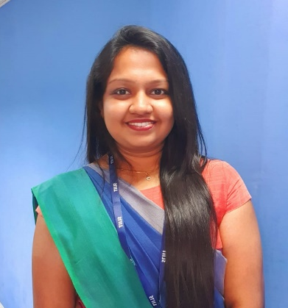
Meet the Team
Ms. Laneesha Ruggahakotuwa
BSc (Hons) in Information
Technology Specializing In
Cyber Security - SLIIT
MSc in Cyber Security – SLIIT
Teaching Areas
Cybersecurity
Machine Learning

Slide 4

Meet the Team
Ms. Menaka Moonamaldeniya.
BSc (Hons) in Information
Technology Specializing in
Cyber Security – SLIIT
Teaching Areas
Networking
Cybersecurity

Slide 5
Module Outline
Available on Course web
Read and Discuss

Slide 6
Module Delivery
Module Clarifications
Within the lecture, tutorial and lab sessions
Via Email
Type | Duration | Time | Location | Delivery
Lecture | 2 Hours | Tuesday 1.30 – 3.30 | 13H-C | Lecturer
Tutorial | 1 Hour | Monday 3.30 – 4.30 | 13H-C | Lecturer
Lab | 2 Hours | Allocated | Allocated | Instructor

Slide 7
Module Groups
Batch has been split into 2 groups – Not finalised
Only 1 group will be allowed on campus each week
The other batch will be studying online

Slide 8
Delivery Method – Lectures and Tutorials
Lectures will be recorded each week
Uploaded on EduScope
Link will be made available on CourseWeb
In the following weeks lecture and tutorial sessions will act as a revision for the lecture
2 lectures will be covered in each session after the first
Students are expected to watch the lecture before coming to class

Slide 9
Delivery Method – Labs
Will be conducted in mixed mode
6 labs will be conducted physically
6 labs will be conducted online
Students are expected to complete all 12 labs and clarify any doubts/questions from module team

Slide 10
Module Learning Outcomes
At the end of the module you will be able to
Design and develop database solutions for real world applications.
Apply relational query languages and database programming languages in database applications.
Evaluate query plans and recommend solutions to speed up the database servers.
Apply appropriate solutions to address security and performance concerns related to databases.

Slide 11
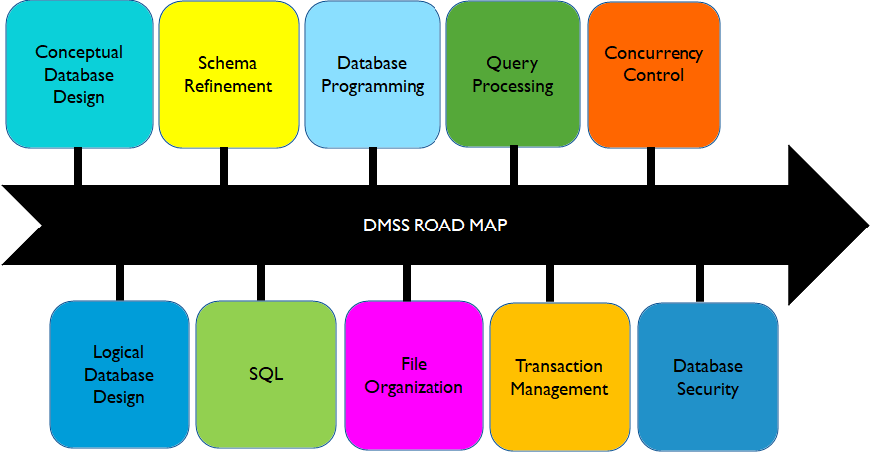
Module Topics

Slide 12
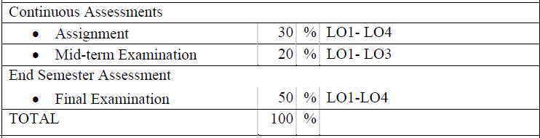
Module Assessment Criteria

Slide 13
LMS
All materials will be published on courseweb - http://courseweb.sliit.lk
(Module outline, lectures, tutorials, labs, extra readings, assignments, notices)
Enrollment Key - IE2042
Check the DMSS Page frequently ;)
Content will be uploaded on a weekly basis

Slide 14
Recommended Books
Elmasri, R. and Navathe, S.B., Fundamentals of Database Systems, 5th edition., Addison-Wesley
R. Ramakrishnan & J. Gehrke, Database Management Systems
R. Rankins, P. Bertucci, C. Gallelli, and A. T. Silverstein, Microsoft SQL Server 2014 Unleashed, 1st ed. INpolis, IN: Sams, 2015.
Syverson and J. Murach, Murach's SQL server 2016 for developers: training and reference. Fresno, CA: Mike Murach & Associates, 2016.

Slide 15
Student Expectations
Attendance and interaction during,
Lectures
Tutorials
Labs
Submission of assessments on time and per regulations
Adherence to good academic practices

Slide 16
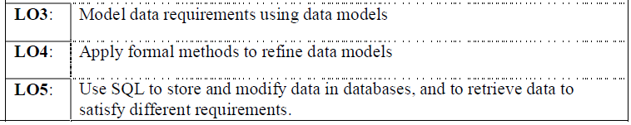
Module Expectations
The module has no formal prerequisites
All students have followed and completed IT1090
Information Systems and Data Modeling
Teaching in this module depend on below ILO’s

Slide 17
In the next class
We will answer questions about the relevant content covered in the previous module
Check Course-Web for the questions
Students are expected to revise the relevant information and come for physical classes

Slide 18


